Slide 1
Network Dissection:
Quantifying Interpretability of Deep Visual Representations
Bolei Zhou*
MIT
Joint work with David Bau*, Aditya Khosla, Aude Oliva, Antonio Torralba
* Indicates equal contribution

Slide 2
Deep ConvNet for Visual Recognition
2012: AlexNet
5 conv. layers
2014: VGG
16 conv. layers
2015: GoogLeNet
22 conv. layers
2016: ResNet
>100 conv. layers
What have been learned inside?
How to compare the internal representations?
Error: 15.3%
Error: 8.5%
Error: 7.8%
Error: 4.4%

Slide 3
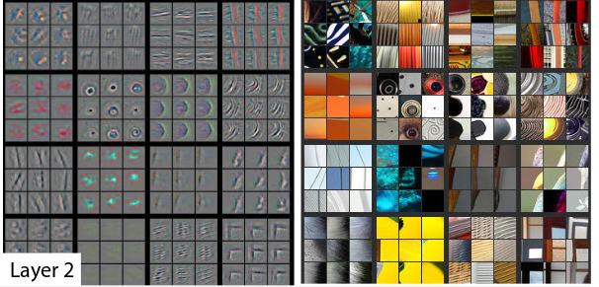
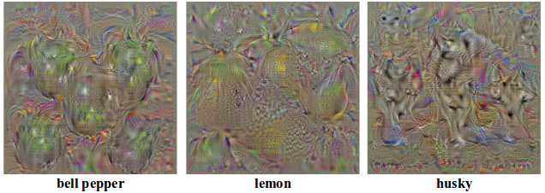
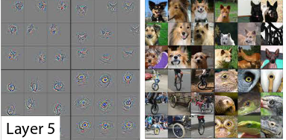
Previous Work on Network Visualization
Deconvolution
Back-propagation
Top activated images
Simonyan et al., ICLR 2015 workshop, 2014
Zeiler et al., ECCV 2014.
Girshick et al., CVPR 2014
Inceptionism. Google Blog. June 2015

Slide 4
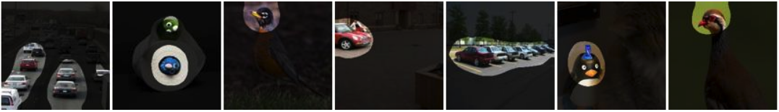
Goal: From Visualization to Interpretation
Top Activated Images
Interpretation: lamp
Score: 0.15
Unit 1
Top Activated Images
Interpretation: car
Score: 0.02
Unit 4

Slide 5
Approach: Test units for semantic segmentation
Unit 1 Top activated images
Lamp Intersection over Union (IoU)= 0.12

Slide 6
Network Dissection
Quantifying the interpretability of units through segmentation
Forward pass

Slide 7
Broadly and Densely (Broden) Annotated Dataset
ADE20K
Zhou et al, CVPR’17
Pascal Context
Mottaghi et al, CVPR’14
Pascal Part
Chen et al, CVPR’14
Open-Surfaces
Bell et al, SIGGRAPH’14
Describable Textures
Cimpoi et al, CVPR’14
Colors
Total = 63,305 images
1,197 visual concepts

Slide 8
AlexNet trained on
conv5, 256 units
Living room
Kitchen
Coast
…
365 categories
Histogram of object detectors: Detector:81/256, Unique Detector:40 (Units with IoU>0.04)

Slide 9
conv5 unit 79 car (object) IoU=0.13
conv5 unit 107 road (object) IoU=0.15
Histogram of object detectors: Detector:81/256, Unique Detector:40 (Units with IoU>0.04)

Slide 10
conv5 unit 144 mountain (object) IoU=0.13
conv5 unit 200 mountain (object) IoU=0.11
Histogram of object detectors: Detector:81/256, Unique Detector:40 (Units with IoU>0.04)
10

Slide 11
Dissection Report

Slide 12
Architectures
Supervised Learning
AlexNet
VGG
GoogLeNet
ResNet
Self-Supervised Learning
Context prediction, ICCV’15
Solving puzzle, ECCV’16
Colorization, ECCV’16
Audio prediction, ECCV’16
12

Slide 13
Places
ImageNet

Slide 14
Supervised AlexNet
Self-supervised AlexNet

Slide 15
Supervised VGG, GoogLeNet, ResNet
Supervised AlexNet
Self-supervised AlexNet

Slide 16
House
Airplane
AlexNet
VGG
GoogLeNet
ResNet

Slide 17
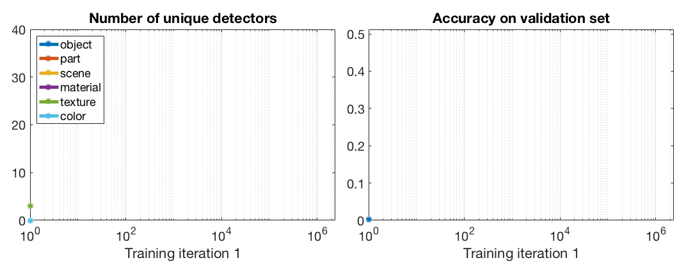
Emergence of Interpretable Units during Training

Slide 18
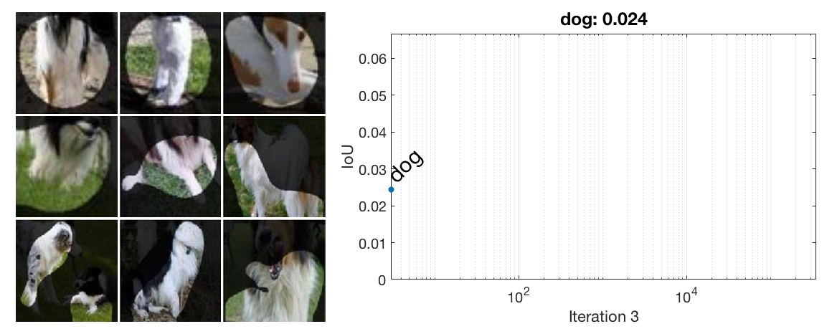
Fine-tuning from ImageNet to Places
Unit 8 at conv5 layer
Before fine-tuning

Slide 19
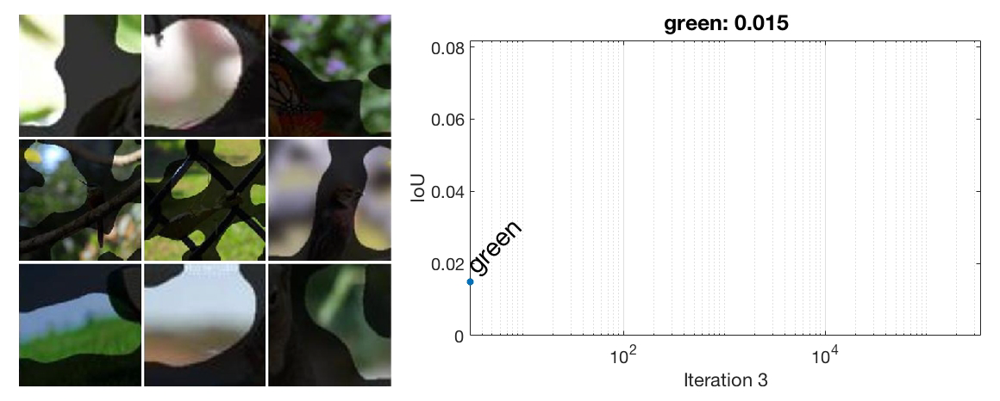
Fine-tuning from ImageNet to Places
Unit 52 at conv5 layer
Before fine-tuning

Slide 20
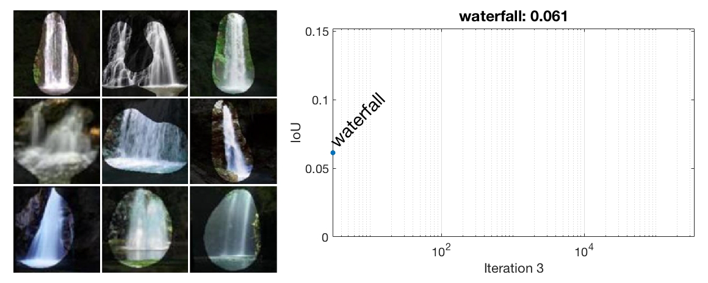
Fine-tuning from Places to ImageNet
Unit 35 at conv5 layer
Before fine-tuning

Slide 21
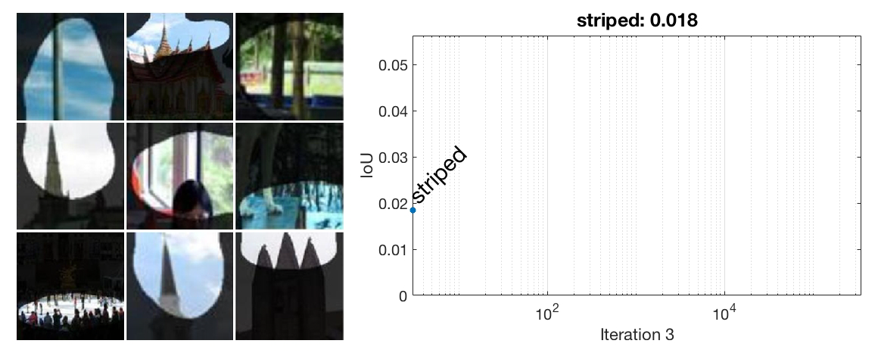
Fine-tuning from Places to ImageNet
Unit 103 at conv5 layer
Before fine-tuning

Slide 22
Interpretable Units in DenseNet

Slide 23
Conclusion
Code and more visualizations are at http://netdissect.csail.mit.edu
Welcome to the Poster #11 this afternoon.
Living room
Kitchen
Coast
Theater
…
Dissection Report
Network Dissection
unit 79 car, IoU=0.13
unit 107 road, IoU=0.15

